Slide 1


Slide 2
On building a diabetes centric knowledge base via mining the web
Joseph Rhodes / ONR

Slide 3
Goals
Approach to constructing diabetes-centric knowledge base (DKB)
Algorithm to extract a subset of overall knowledge base to form the target diabetes KB (forward or backward chaining?)
Show the data in DKB are rich and high-quality

Slide 4
Background
Diabetes is a major threat to human health and it’s prevalence is high in Asian countries
China – 92.3 million
India – 63 million

Slide 5
Background
Previous research – use of EMR can improve quality of care
knowledge – unstructured text -> structured info
Previous methods fail to capture abbreviations and nonstandard terminologies

Slide 6
Background
Online portals – narrow focus on healthcare info and services
Combine 8 of the Chinese portals into a knowledge base

Slide 7
Background
Method for knowledge extraction
Wrapper-based extraction strategy
Representation
Ontological structure
Mapping strategy
Clean extracted data (resolve conflicting class descriptions of the same instance)
Detect equivalent instances

Slide 8
Background
Representation
Ontological structure
Mapping strategy
Clean extracted data (resolve conflicting class descriptions of the same instance)
Detect equivalent instances

Slide 9
Brief Overview of KB
Joseph Rhodes / ONR

Slide 10

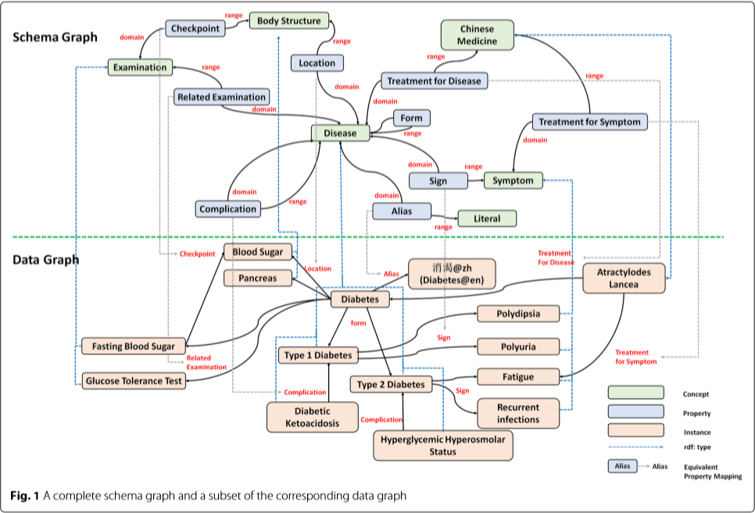
Notes:
V – Verticies
L – Edge labels
E – Edges

Slide 11
Background
Representation
Ontological structure
Mapping strategy
Clean extracted data (resolve conflicting class descriptions of the same instance)
Detect equivalent instances

Slide 12
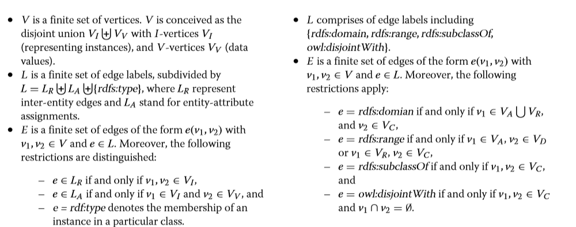
Notes:
V – Verticies
L – Edge labels
E – Edges

Slide 13
Data Sources Used for DKB Construction
Joseph Rhodes / ONR

Slide 14

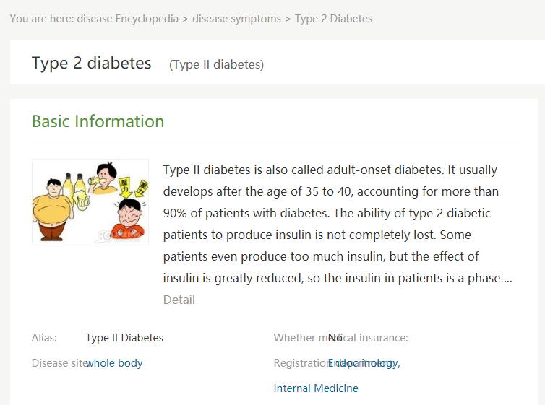
Iixtnb = type 2 diabetes
Jbk.39.net/{identifier}

Slide 15
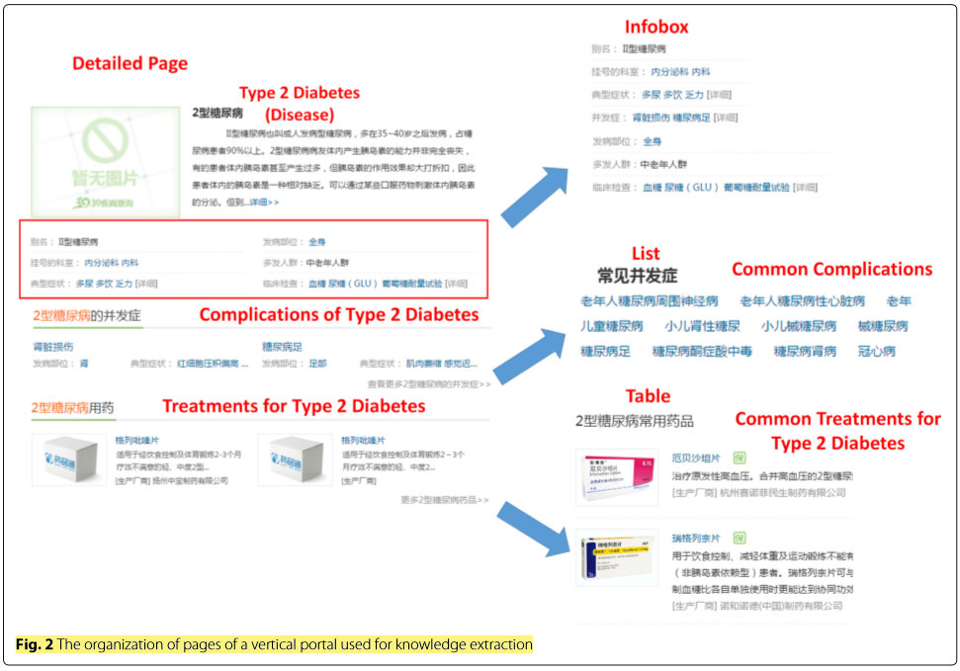
Notes:
V – Verticies
L – Edge labels
E – Edges

Slide 16
Notes:
V – Verticies
L – Edge labels
E – Edges

Slide 17
Related Work
Joseph Rhodes / ONR

Slide 18
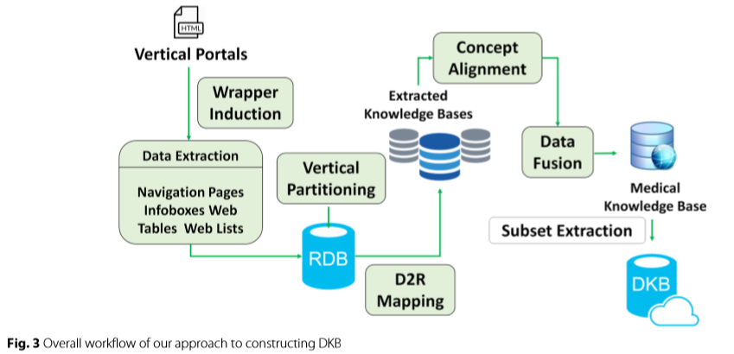
Notes:
V – Verticies
L – Edge labels
E – Edges

Slide 19
3 lines of related research
Existing Knowledge Base Constructed Via Mining the Web
Medical Knowledge Base
Diabetes Knowledge Base

Slide 20
Methods
Joseph Rhodes / ONR

Slide 21
Extract Semantic data
HTML pages
Wrapper induction
Medical Knowledge Base
Diabetes Knowledge Base

Slide 22
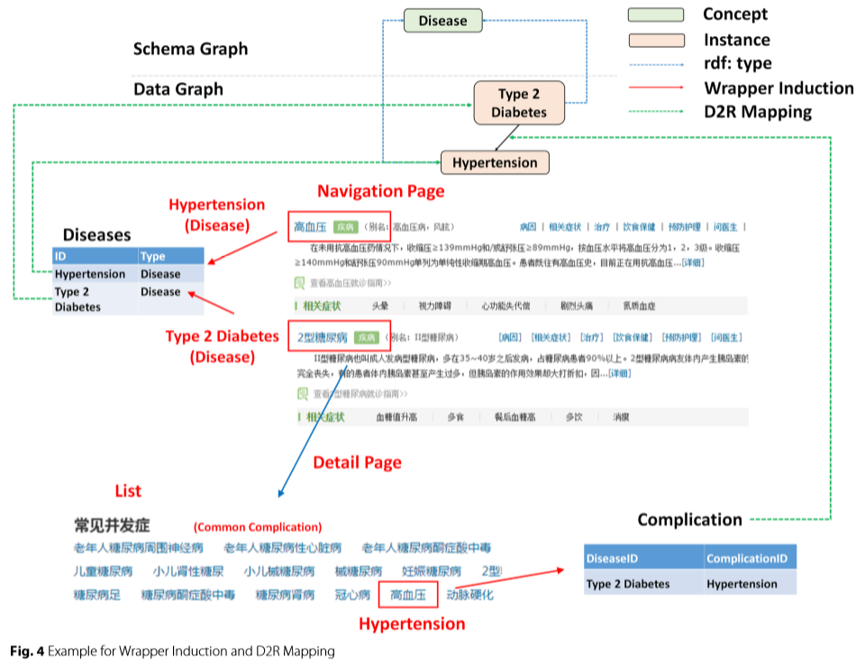
Notes:
V – Verticies
L – Edge labels
E – Edges

Slide 23
Extract Semantic data
HTML pages
Wrapper induction
Medical Knowledge Base
Diabetes Knowledge Base

